Slide 1
Selected topics 1
Python
Nashwa Nageh

Slide 2
Agenda
syntax

Slide 3
Syntax
Indentation refers to the spaces at the beginning of a code line.
Where in other programming languages the indentation in code is for readability only, the indentation in Python is very important.
Python uses indentation to indicate a block of code.
In Python, all the lines of code are arranged according to blocks, so it becomes easier for you to spot an error.

Slide 4
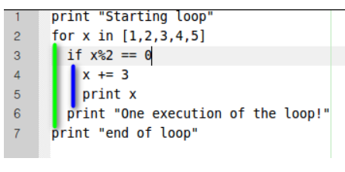
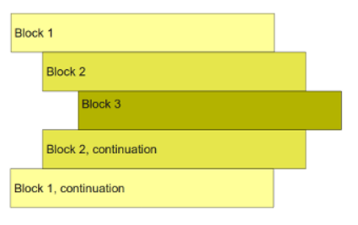
For example, if you have used the if statement in any line, the next line must have an indentation.

Slide 5
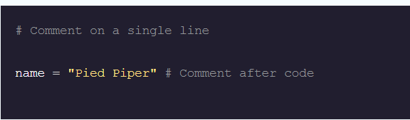
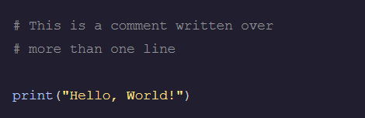
Comments
A comment is a piece of text within a program that is not executed. It can be used to provide additional information to aid in understanding the code.
Single-line Comments Multi-line Comments

Slide 6
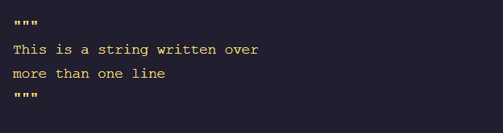
Comments
Another, less official way of writing comments in Python is to use a multi-line string.
Python will ignore string literals that are not assigned to a variable
Multi-line strings (created by surrounding text with triple quotes """) can be used as de facto comments:

Slide 7
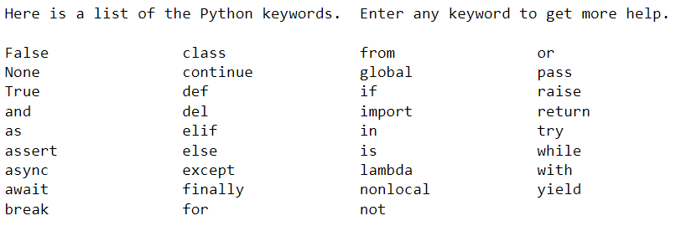
Reserved Keywords in Python
Reserved words (also called keywords) are defined with predefined meaning and syntax in the language. These keywords must be used to develop programming instructions. Reserved words can’t be used as identifiers for other programming elements like name of variable, function etc.
help("keywords")

Slide 8
Python Exception Handling
Error in Python can be of two types
Syntax errors and Exceptions.
Errors are problems in a program due to which the program will stop the execution.
Exceptions are raised when some internal events occur which change the normal flow of the program
In Python, there are several built-in exceptions that can be raised when an error occurs during the execution of a program.

Slide 9
Different types of exceptions in python:
SyntaxError: This exception is raised when the interpreter encounters a syntax error in the code, such as a misspelled keyword, a missing colon, or an unbalanced parenthesis.
TypeError: This exception is raised when an operation or function is applied to an object of the wrong type, such as adding a string to an integer.
NameError: This exception is raised when a variable or function name is not found in the current scope.
IndexError: This exception is raised when an index is out of range for a list, tuple, or other sequence types.
KeyError: This exception is raised when a key is not found in a dictionary.

Slide 10
Different types of exceptions in python:
ValueError: This exception is raised when a function or method is called with an invalid argument or input, such as trying to convert a string to an integer when the string does not represent a valid integer.
AttributeError: This exception is raised when an attribute or method is not found on an object, such as trying to access a non-existent attribute of a class instance.
IOError: This exception is raised when an I/O operation, such as reading or writing a file, fails due to an input/output error.
ZeroDivisionError: This exception is raised when an attempt is made to divide a number by zero.
ImportError: This exception is raised when an import statement fails to find or load a module

Slide 11
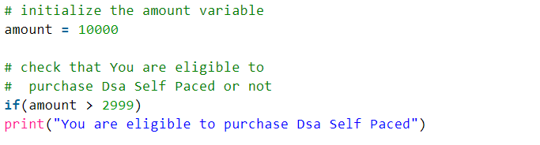

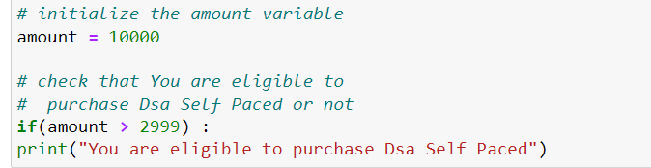
Example in Python Exception
Example 1:
Example 2:

Slide 12
Escape sequence characters
An escape sequence is a sequence of characters that, when used inside a character or string, does not represent itself but is converted into another character or series of characters that may be difficult or impossible to express directly, like newline (\n), tab (\t), and so on
In the escape sequence, a character is preceded by a backslash (\) followed by the character
This character serves as an escape sequence initiator, and every character (one or more) following it is considered an escape sequence

Slide 13
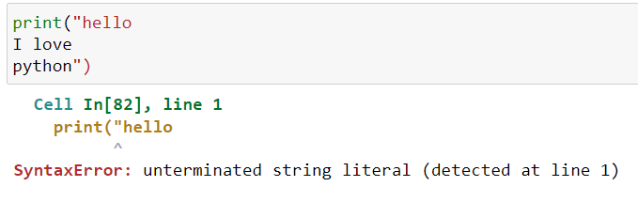
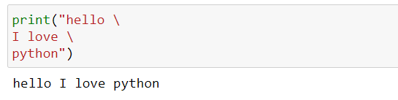
Escape sequence characters
\ : Escape newline and escape \
Example 1
Example 2

Slide 14
List of Escape Sequence Available in Python
Escape Sequence | Meaning
\’ | Single quote Example: print('love \' python’) Output: love ' python
\" | Double quote Example: print(”love \” python”) Output: love ” python
\\ | Backslash Example: print('Interview\\Bit') Output: Interview\Bit
\n | Newline Example: print('Interview\nBit’) Output: Interview Bit
\r | Carriage Return Example: print("12345678 \rpython") Output: python78
\t | Horizontal Tab Example: print('Interview\tBit’) Output: Interview Bit
\b | Backspace, This escape sequence is used to remove the space between the words. Example: print('Interview \bBit’) Output: InterviewBit
\uxxxxxxx | Unicode character with a 32-bit hex value Example: ('\u00001000’ , '\u1020’) Output: 1000
\000 | Character with octal value ooo Example: print("\110\105\114\114\117\040\127\117\122\114\104") Output: Hello World
\xhh | Character with hex value hh Example: print("\x48\x45\x4C\x4C\x4F\x20\x57\x4F\x52\x4C\x44") Output: Hello World

Slide 15
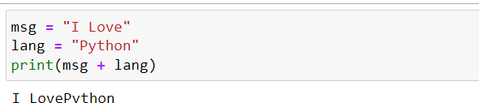


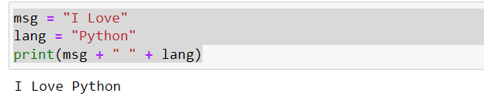



Concatenation
String concatenation means add strings together.
Use the + character to add a variable to another variable.
Example 3:
Example 1:
Note: for put space between words
Example 2:

Slide 16
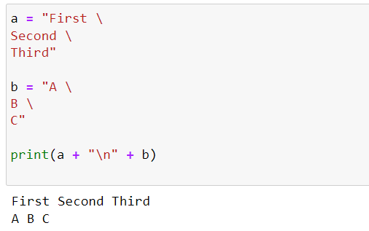
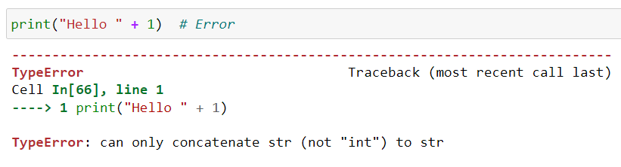

Concatenation
Example 4:
Example 5:

Slide 17
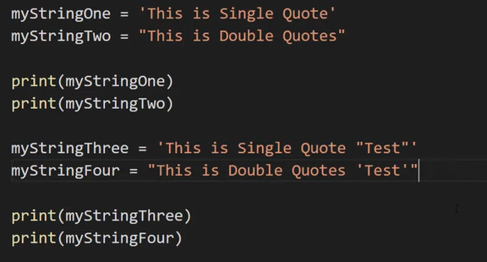


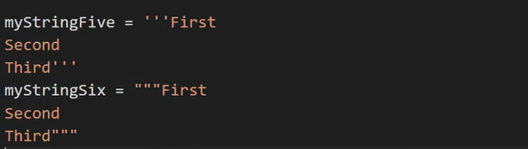

String
output
output
output

Slide 18
Strings - Indexing And Slicing
Slicing and indexing are two fundamental concepts in Python. They help you access specific elements in a sequence, such as a list, tuple or string.
All data in python are object
Object can contain elements
Every element has own index
Python use zero based index(index start from zero)

Slide 19
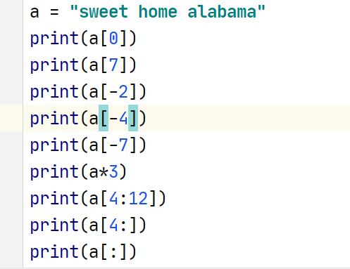
Strings - Indexing And Slicing

Slide 20
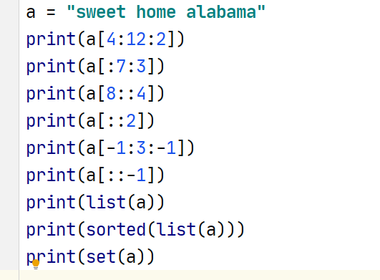
Strings - Indexing And Slicing

Slide 21
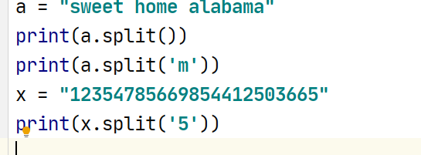

Strings - Indexing And Slicing

Slide 22
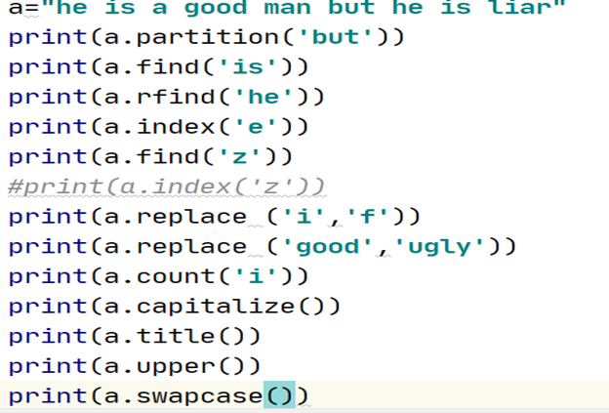










Strings - Indexing And Slicing

Slide 23
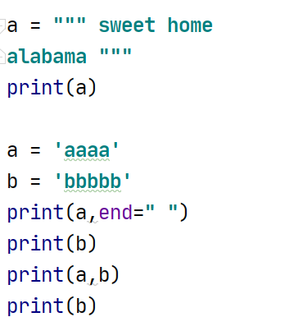
Strings - Indexing And Slicing

Slide 24
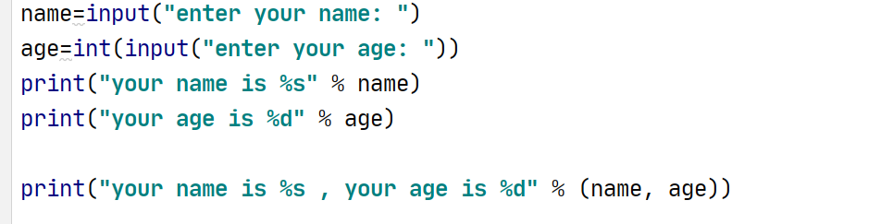
Strings

Slide 25
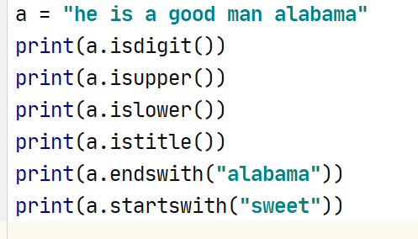
Strings - Indexing And Slicing

Slide 26
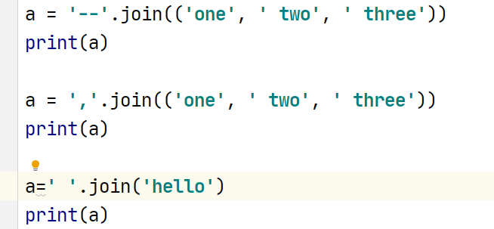
Strings - Indexing And Slicing

